Slide 1
Introduction
Title: Music App with Voice Search
Subtitle: Innovative Way to Discover Your Music

Slide 2
Team members
Udhaya Kumar
Sathish Kumar
Praveen Kumar
Gopinath

Slide 3
Project explanation
Content:
A modern music app with voice search for faster music
discovery.
Focus on user experience and accessibility.
Voice Searching:
Voice searching is a user-friendly feature that allows users to find music or other content in your app by speaking their queries instead of typing them

Slide 4
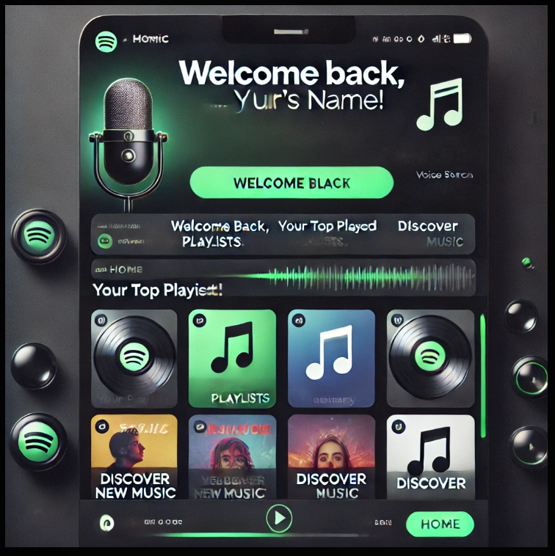
Key Features
Content:
Voice Search: Search for songs using voice commands.
Personalized Recommendations: AI-curated playlists.
Offline Mode: Download and listen offline.
Multi-Language Support: Interact in various languages.

Slide 5
Why Choose This App ?
Content:
Hands-free and fast music discovery.
Personalized user experience.
Voice searching for songs, artists, and playlists.
Many podcast to keep you entertained.

Slide 6
Benefits
Content:
Enhances app accessibility.
It free to use no need to pay for music.
Faster and hands-free music.
Easy navigation for users.
Converts speech to text using speech recognition

Slide 7
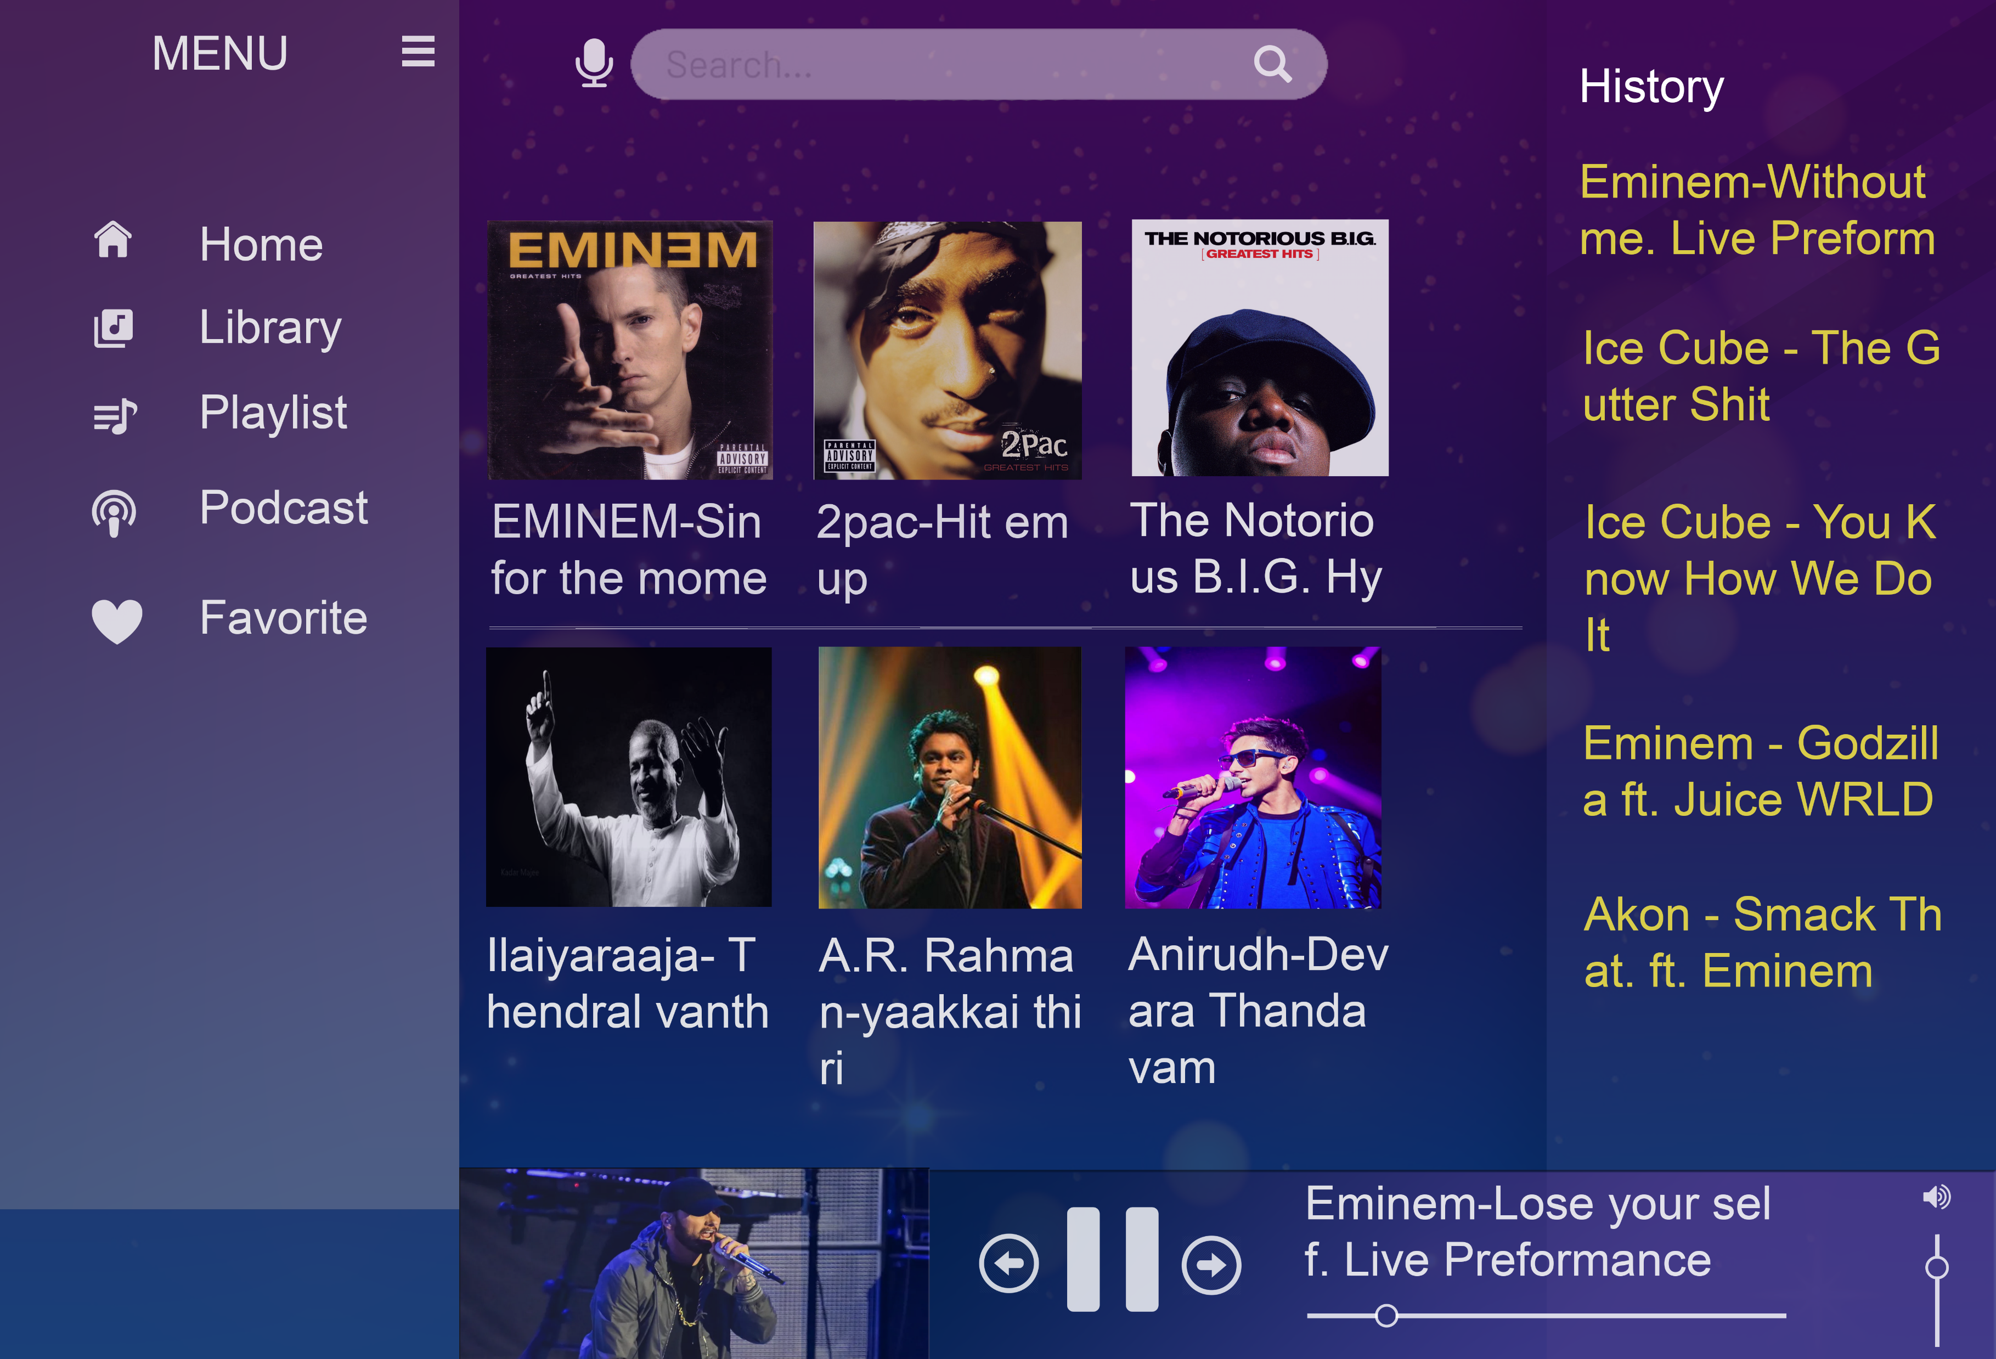
Model images

Slide 8
Conclusion
Future scope: Additional features like mood-based music suggestions Developing a project and learning something is very useful and very
Important for job interviews. It gives an experience of working with a team
co-operate.

Slide 9
Thank you

